Slide 1
Predicting the Hourly Wage of Full-Time Employees in Canada
Harpreet Kang
Student ID: 500127314
Git Hub Link: https://github.com/harpkang/CIND820_CAPSTONE

Slide 2
Work Flow
Data Understanding
Data Preperation
Exploratory Analysis
Modelling
Validation
Commuication
Next Steps

Slide 3

OVERVIEW

Slide 4

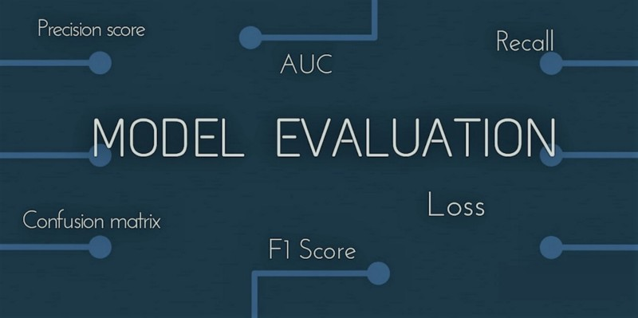
Project Scope
Problem: What machine learning models can be used to predict an individual's wage with…
minimum error.
Notes:
full-time employees who had one main job, were working full-time on a permanent basis, and were not in school

Slide 5
Research Questions
Which classification model, with tuned hyper parameters, will have a high accuracy and f1-score, and balanced precision and recall?
What do data mining techniques, specifically association rules, reveal about the link between a high education level and above average hourly earnings?
Which non-linear regression model, with tuned hyper parameters, will have a strong RMSE in regard to the continuous response variable?
Notes:
With a national average hourly wage of $33.55 in 2023

Slide 6




Python
Non-Linear Regression
Apriori
Classification
Notes:
The tools that were used.

Slide 7

Data Understanding & Preparation
Notes:
Data Preparation

Slide 8
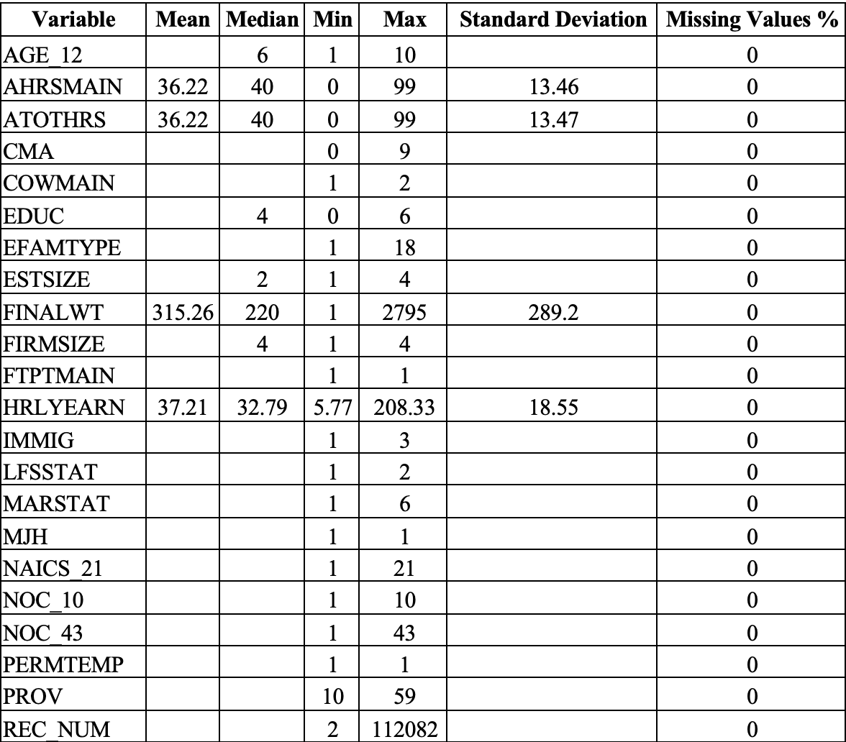
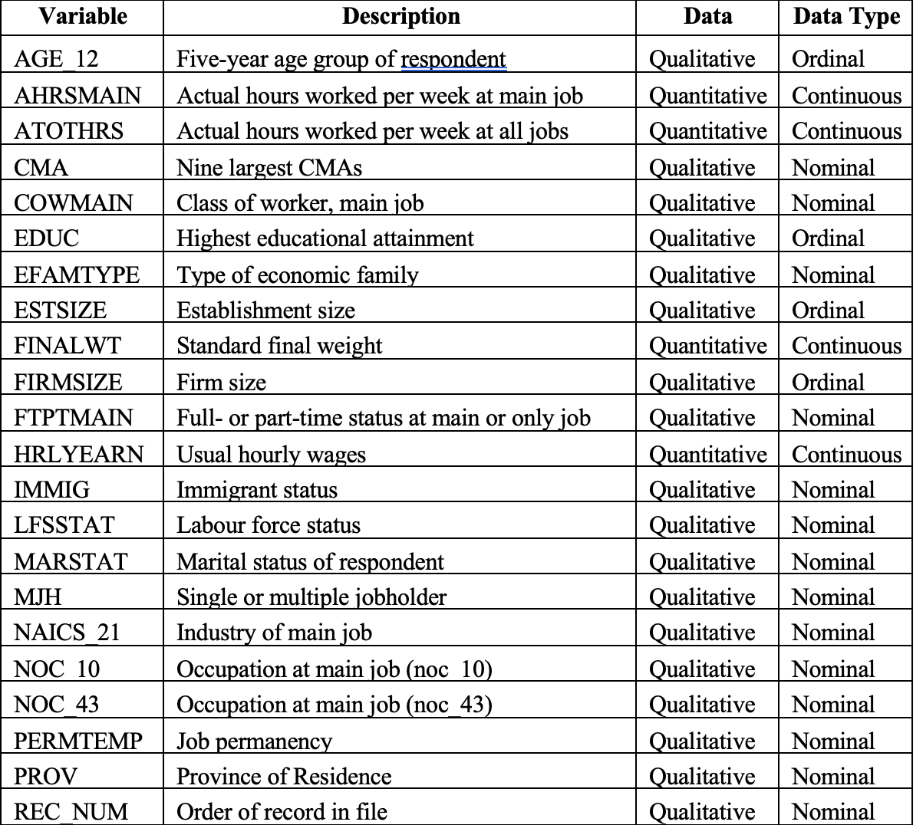
Understanding the Dataset
LFS (Jan 2024 to Apr 2024)
442, 576 Rows
60 Attributes
Notes:
Observational Study
The survey is randomly taken of 56, 000 households across Canada of all household members over the age of 15 (Government of Canada, Statistics Canada, 2024).
The information contains demographic characteristics such as age, gender, employment status, and labour market characteristics such as the employment status, profession, and industry to name a few
It is mandatory by law, the Statistic Act, to complete the LFS in good faith (Government of Canada, Statistics Canada, 2024).
The random and independent sampling design is a combination of stratified sampling, where the provinces are the strata, and then clustering, where geographic areas are further granularized to reduce bias and error (Government of Canada, Statistics Canada, 2024).
Stratifying ensures that the diversity of the population is representative, and clustering allows for cost efficiency.

Slide 9
Pre Processing
Train
Test
70 %
30 %
Missing Data
Low Variance
Correlation
Notes:
Train Test Split 70/30
Feature Selection Techniques
Article 6 – Missing Data - Eliminate features that have over 50% of its values missing, and imputing these values would not be correctly justified. The goal is to preserve as much of the data as possible and to prohibit the loss of any information
Missing Data - 26 variables were eliminated from the dataset because they had 50% of its missing values
Low Variance – 8 Features that had a high imbalance were eliminated.

Slide 10
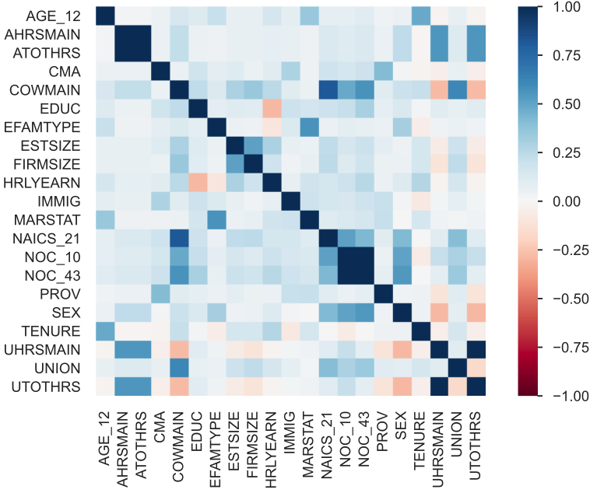
Correlation Matrix
Notes:
(Article 5) – Removing Redundant Features
Y Profile Report after removing missing values and low variance
The risk of overfitting the model is one of these concerns, which can lead to the model not being able to perform well on unseen data.
Thus, it is important to identify and eliminate highly correlated features.
Eliminate the redundant features.
ydata_profling module auto detects data types to apply different correlation methods.
Spearman Correlation is used when two numerical features are assessed, and Cramer’s V association coefficient is used for both when two categorical features are assessed, and when numerical and categorical features are assessed together.
if the correlation coefficient is greater than the default value of 0.50.

Slide 11
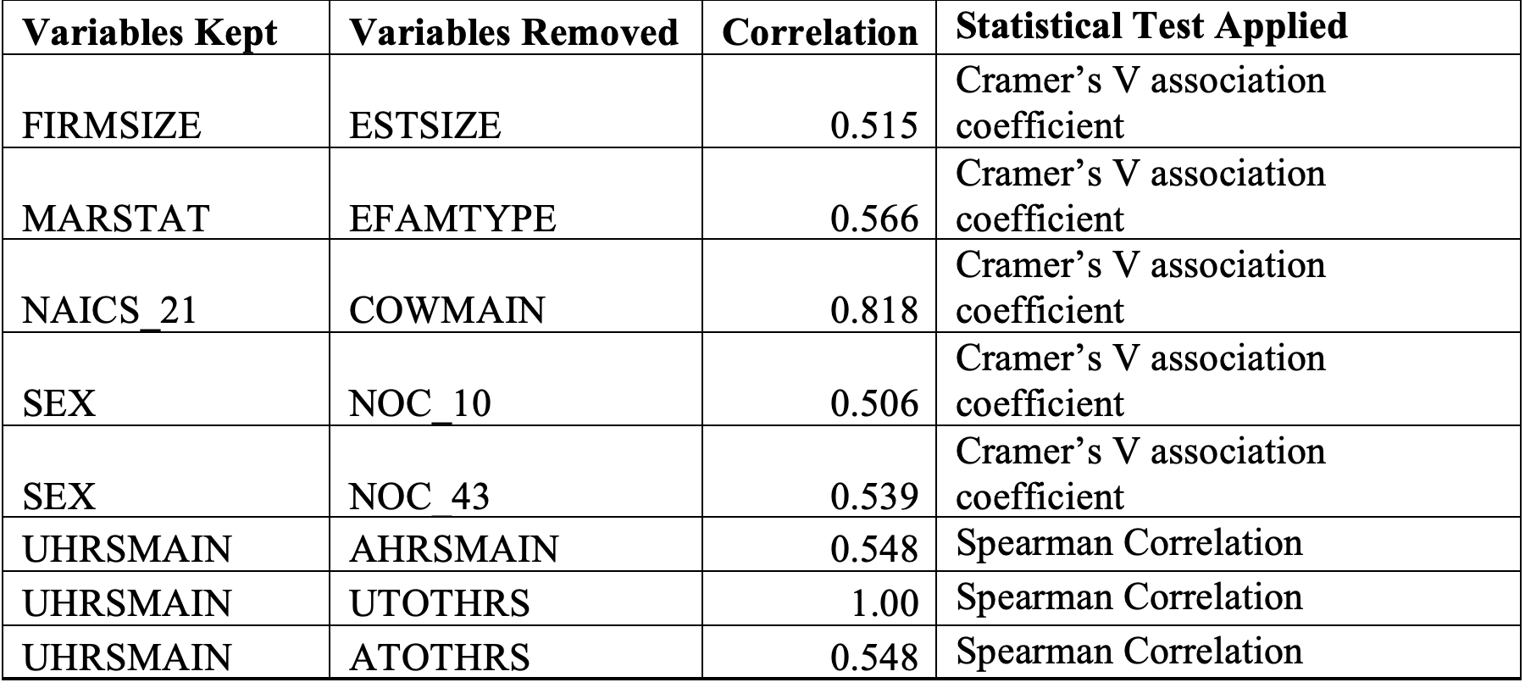
Correlation Analysis

Slide 12
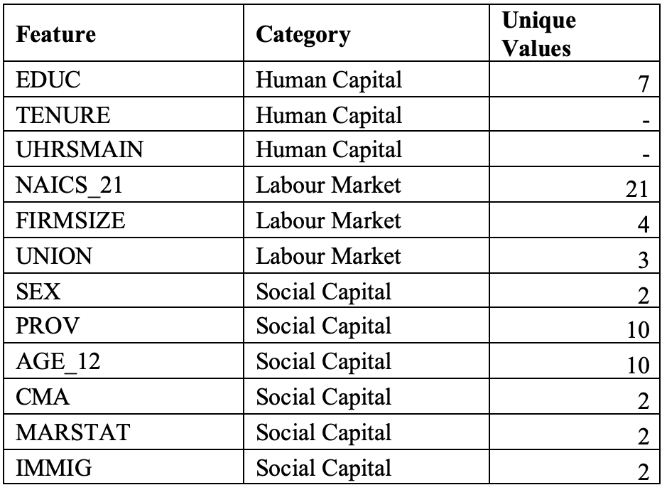
Selected Features
Notes:
The number of dummy variables that are needed are $k−1$, where k is the number of levels for each qualitative variable
Since, there are 9 of these variables, then the total amount of extra features in the dataset would amount to 53, $(63−10$)
Adding the two remaining quantitative features, the grand total becomes 55,
12 features left

Slide 13
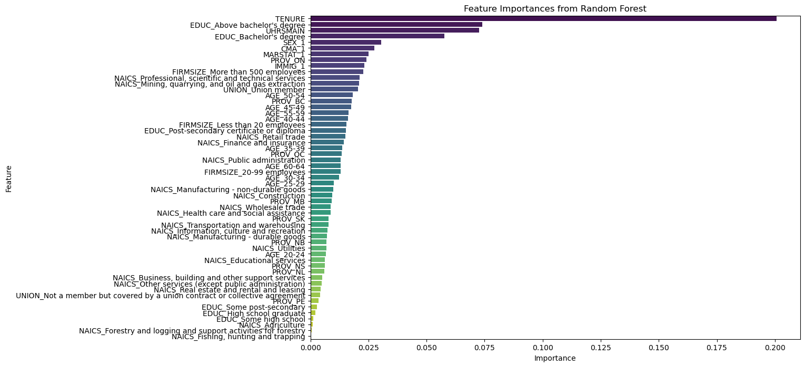
Random Forest Feature Importance
Notes:
The top 5 features of importance are Tenure, Education, Hours Worked, Sex, and CMA

Slide 14
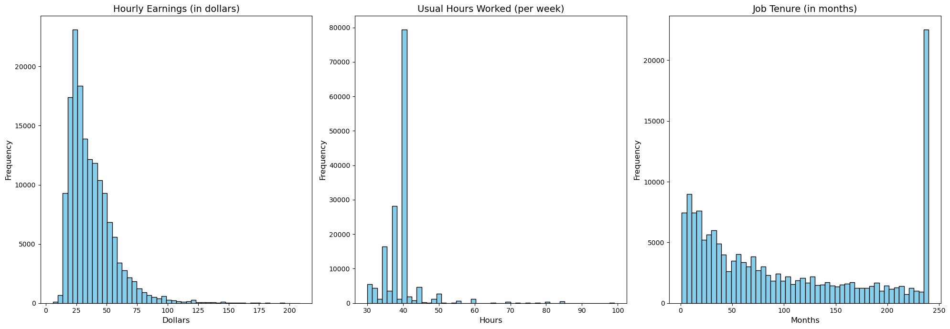
Normality
Notes:
Furthermore, this distribution resembles an exponential distribution because all the random variables are positive and continuous
3 continuous variables

Slide 15
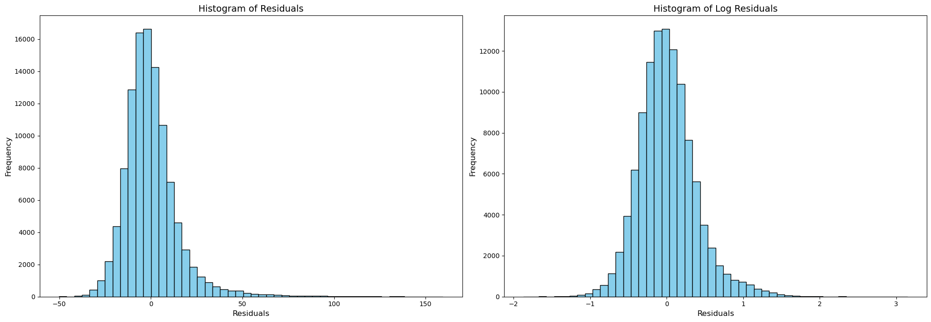
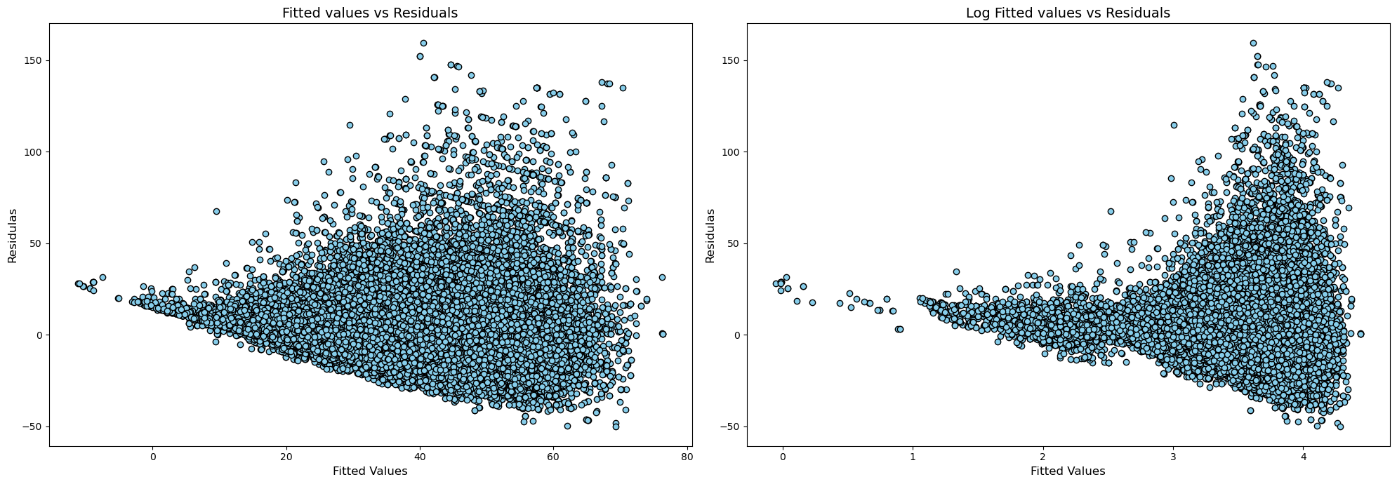
Assumptions of Linear Regression
Notes:
4 Assumptions of the Error Term
Independent
Normally distributed
Common variance
Mean equal to zero.
The main goal of regression is to minimize the deviations between the predicted and original values, thus optimizing the sum of squares for errors, by using the least squares method.
The Durbin-Watson test was used to check for independence
Shapiro-Wilk test will be used to check for normality,
Mean of the residuals will be checked to see whether they are equal to zero, and a scatter plot will be used to visualize whether there is a constant variance among the residuals.
The research found that the Durbin-Watson test result is 2.01, which means the residuals are independent.
The mean of the residuals is 1.71, which indicates that it is very close to 0, thus unbiased.
The Figure at the top shows that the residuals are not perfectly normally distributed and shows a slight skewness towards the right.
The Figure at the bottom indicates that there is no common variance among the residuals.
An attempt at a log transformation of dependent variable did address the normality issue but did not fix the common variance issue.
The reason for the log transformation is because, as shown above on the left, the residuals are not normally distributed, and the common variance assumption does not hold.
When the dependent variable is log transformed at least the residuals are normally distributed as shown on the top right.

Slide 16
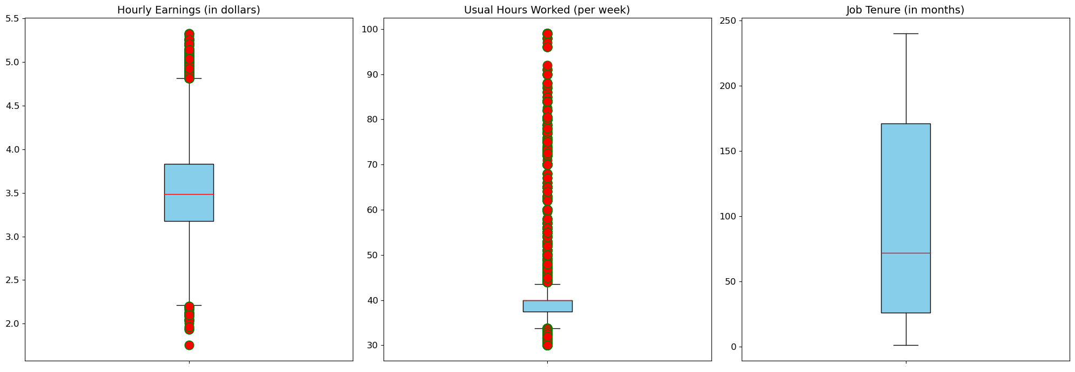
Outliers
Notes:
The two boxplots on left show the outliers highlighted in red, for hourly earnings and usual hours worked respectfully.
Interestingly, there are no outliers in the Tenure variable, the right most boxplot
To remove the outliers in each of these features, a non-parametric statical technique is needed to first identify and then remove them.
The interquartile range method will be used in this research to remove the outliers in both hourly earnings and usual hours worked variables.
It is imperative to remove outliers from the dependent variable because they inevitably reduce the accuracy of the overall model.
Out of 108, 675 records from the training set, the number of outliers are less than 18% of the training dataset, and thus can be eliminated.
Which leave about 90K records to be trained.

Slide 17
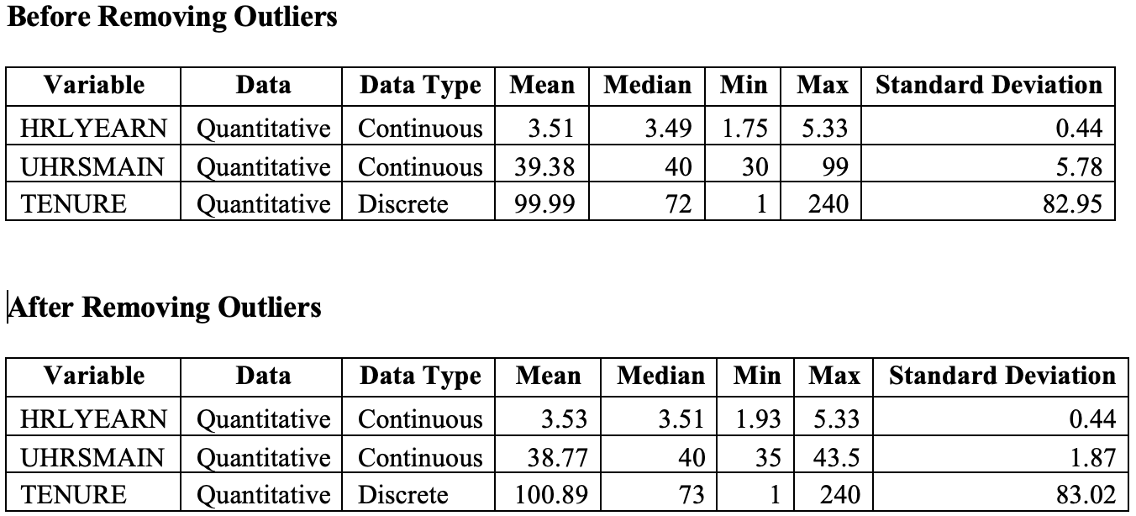
Outliers

Slide 18
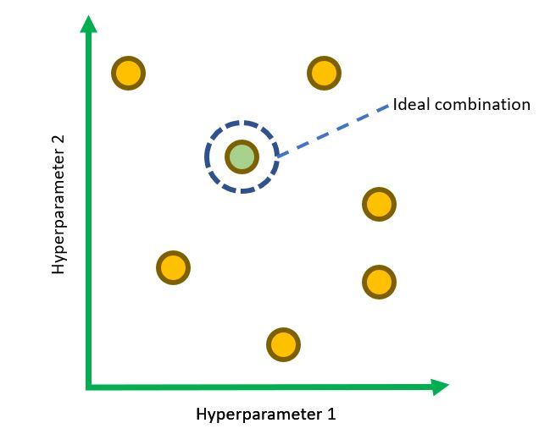
Other Processes Used
K Fold Cross Validation (5 Folds)
Column Transformer
MinMaxScaler
HotOnesEncoder
Pipelines
Randomized Grid Search (5 Iterations)

Slide 19

MODELING

Slide 20
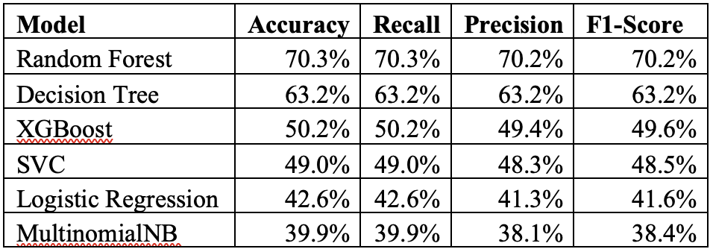
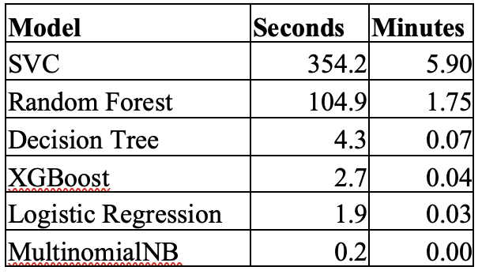
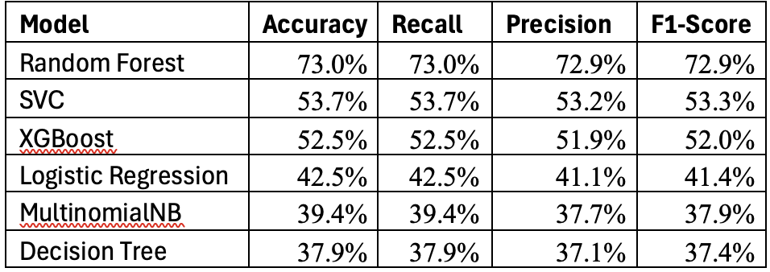
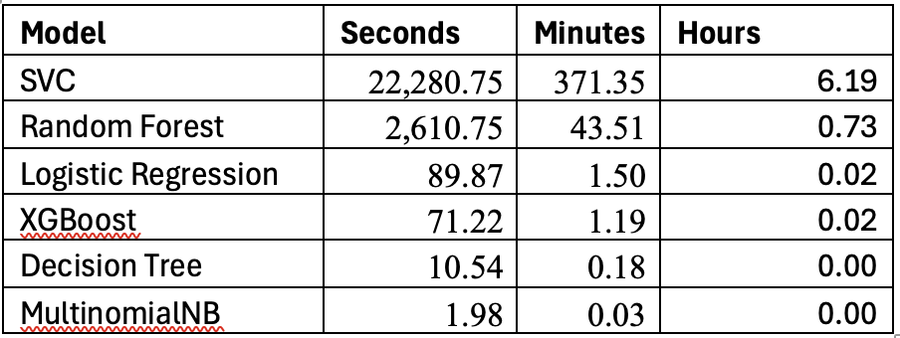
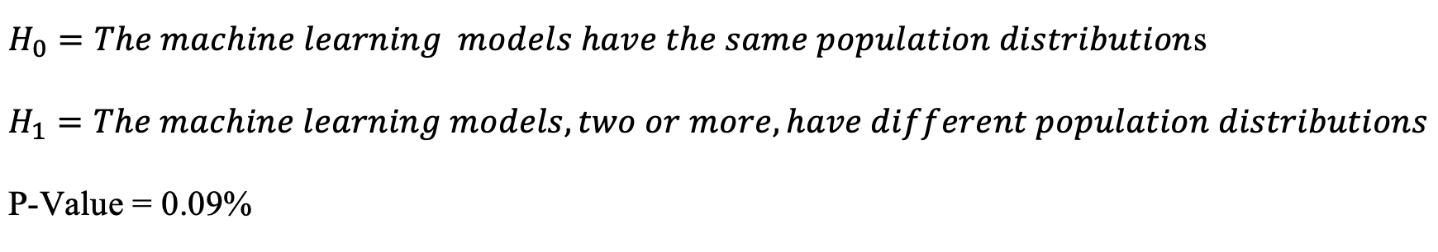
Classification Before and After
Before:
After:
Friedman Test:
Notes:
Article 2

Slide 21
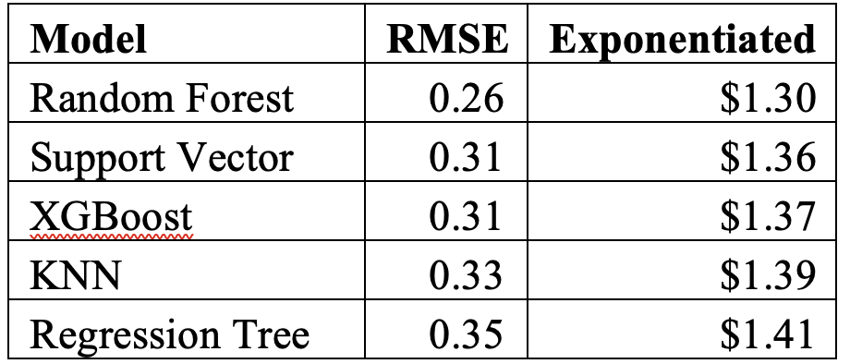
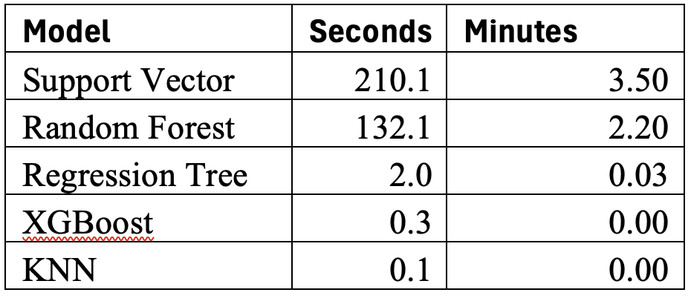
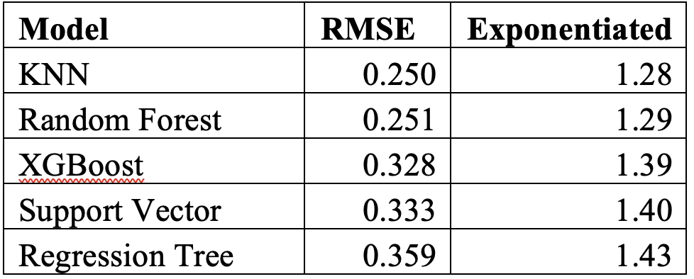
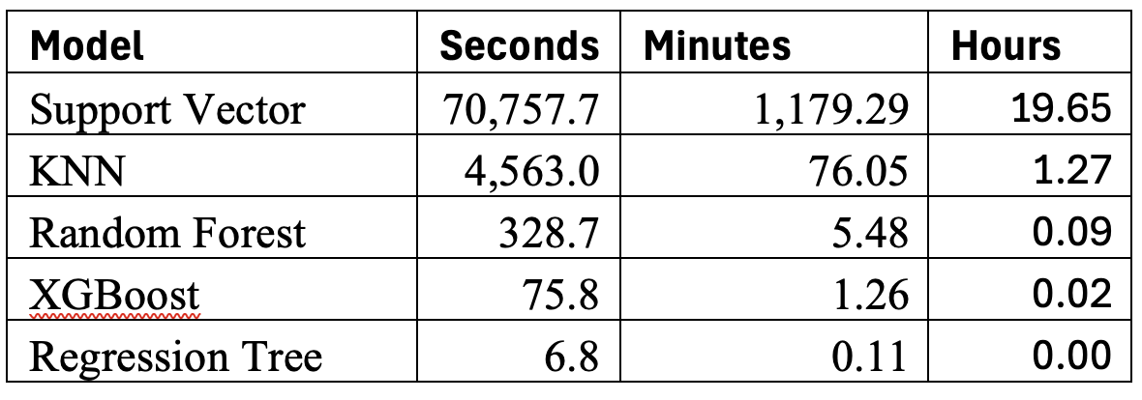
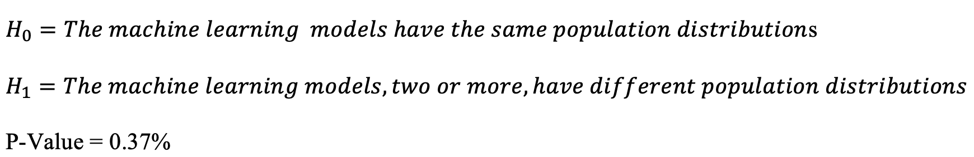
Non-Linear Regression Before and After
Before:
After:
Friedman Test:
Notes:
Article 1 & 3
15 Times Faster

Slide 22
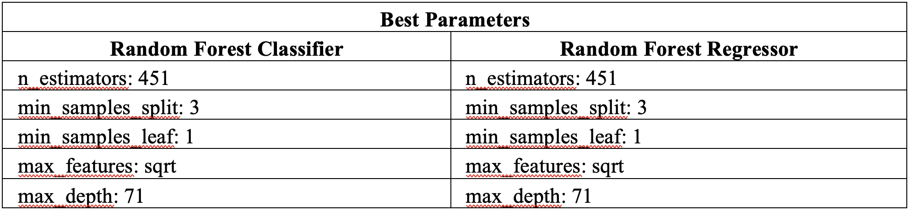
Best Parameters

Slide 23
Knowledge Induction
Support
Confidence
5%
1%
Notes:
Article 4 – Education and Sex had the greatest Lift
The support and confidence levels - 25% and 80% respectively.
The algorithm did not produce any results.

Slide 24
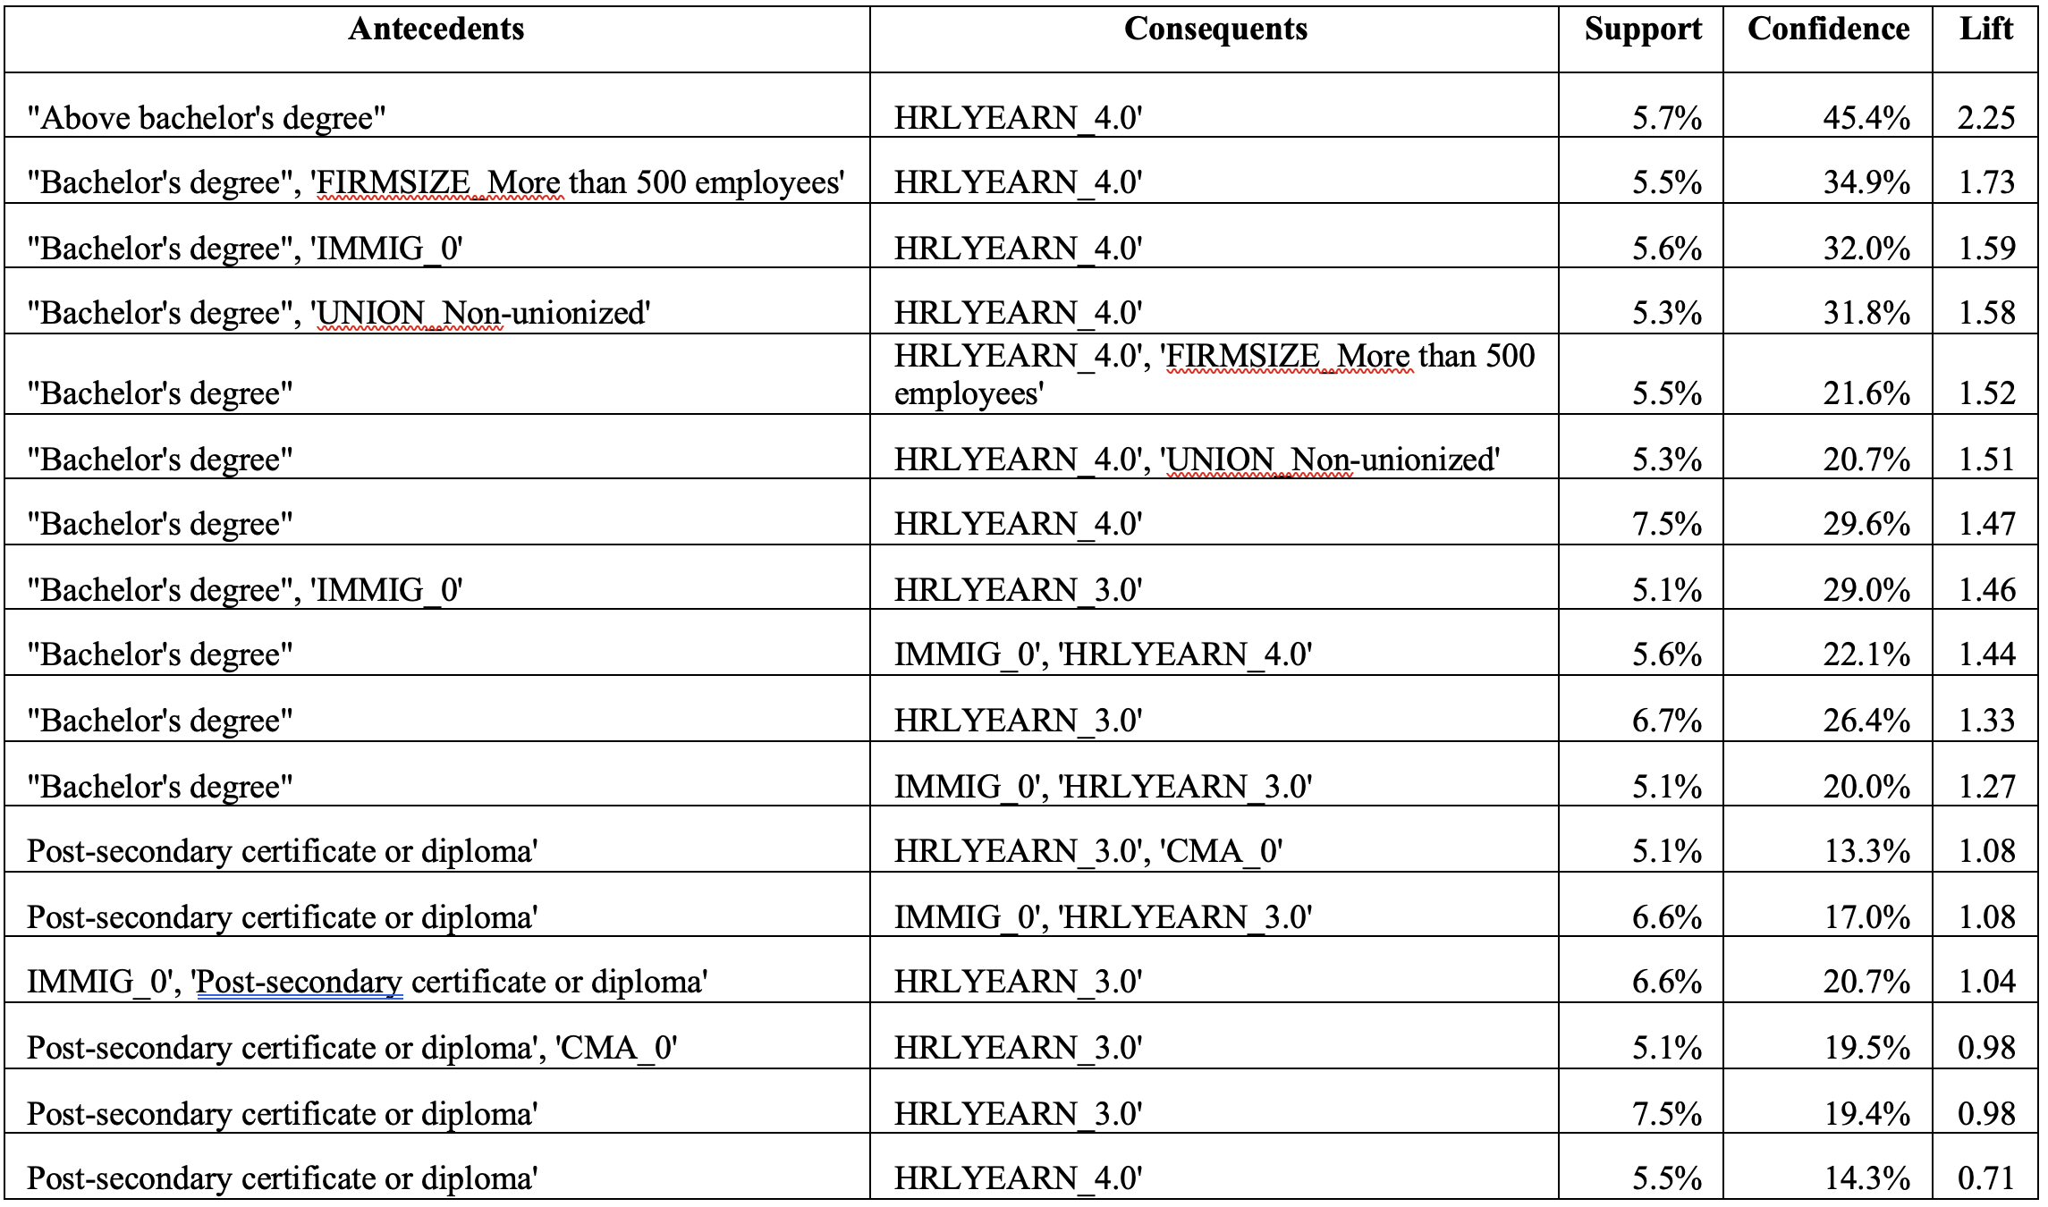
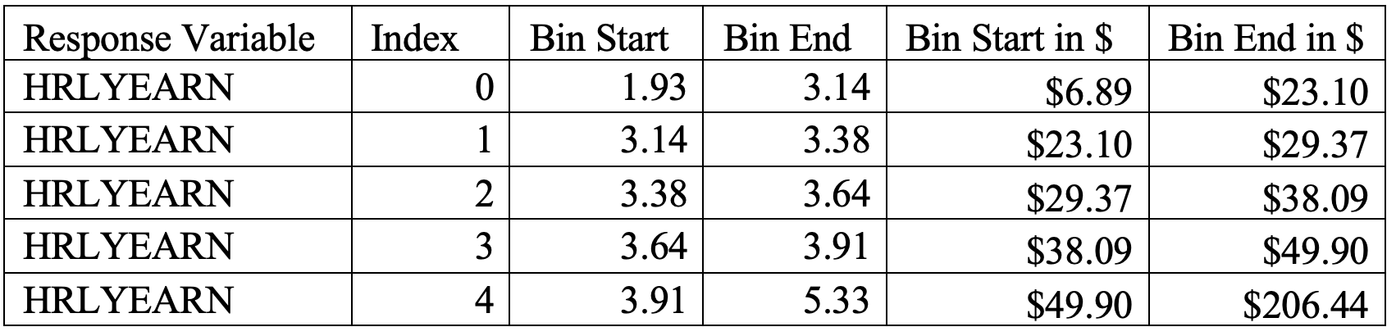
Knowledge Induction
Notes:
As mentioned in article four above, the support and confidence levels were intended to be set to 25% and 80% respectively. However, when the support level was set to 25%, the algorithm did not produce any results.
it clearly shows that an individual with “Above bachelor’s degree” will be in the highest hourly earnings bin, which is between $49.90 and $206.44. The lift is 2.25 indicating a strong positive association, a confidence of 45.4%, and support of 5.7%.
The results are similar to what was found in article 4 above, which is that higher education does indeed increase your hourly earnings.
Interestingly, when examining strictly the antecedent as “Post-secondary certificate or diploma”, and the consequent as either the third or fourth hourly earnings bin, the lift is less than 1. This indicates that there is an inverse relationship between the LHS and RHS, and therefore reducing the likelihood of earning an above average wage.

Slide 25

Limitations
Apple Mac Book Air
Canadian based literature review

Slide 26
Continuity
Neural Networks
Pairwise Interaction between independent variables
Mathews Correlation
Briers Index
Different Levels for Support and Confidence for Apriori

Slide 27

Conclusion
Random Forest Wins!
Education significantly positively influences hourly wage

Slide 28
The End!

